Slide 1


Generalization
COMP8600 Video Assignment
Han Zhang u7235649
Notes:
Hello everyone, I am Han Zhang. My topic is about generalization.

Slide 2
Generalization
Model
Data
Train the model with data
Predict new cases
Aim
Notes:
So first of all, we should know what is generalization.
Once we have some data and a designed model, our aim is not to train the model to perfectly fit all the training data points or let the model memory all the training data, but to (click) learn the pattern hidden in the training data, and make accurate predictions on new samples that have the same pattern. The generalization ability is the ability of the algorithm to adapt to new samples.

Slide 3
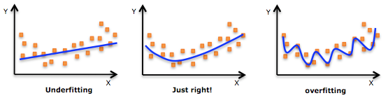
Generalization
Model
Data
Train the model with data
Predict new cases
Aim
Notes:
A model with insufficient generalization ability cannot make good predictions on new samples. For example, when overfitting, the model performs very well on the training set but poorly on the test set.

Slide 4
Question
Select all statements that are true of the generalization behavior of machine learning models.
Notes:
The question I choose is in Quiz 1, that is, select all the correct options regarding generalization behavior of machine learning models.

Slide 5

Option A
Using very complex models in a practical application could yield near-zero training loss, but also yield good generalization.
Notes:
Option A, 读题。This is actually correct. (click) This is in both the slides and the reference book, but I had thought this was incorrect.

Slide 6
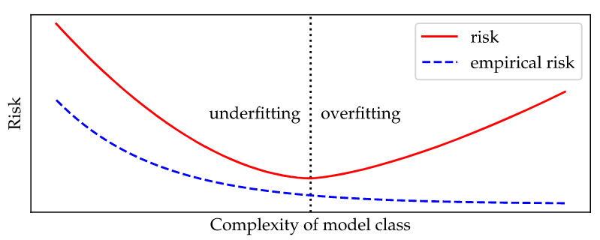
Option A
Using very complex models in a practical application could yield near-zero training loss, but also yield good generalization.
Figure 1. Traditional view of generalization
Notes:
I only considered the traditional view of generalization, which is motivated by a least squares regression analysis. In this view, using very complex models is likely to lead to overfitting, which reduces the generalization ability, as we discussed just now. However, this is not the only case.

Slide 7
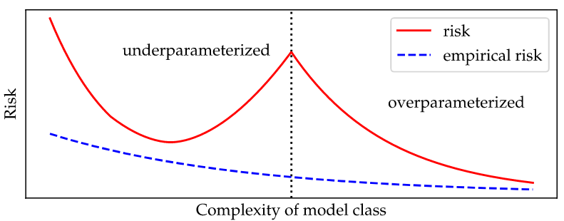
Option A
Using very complex models in a practical application could yield near-zero training loss, but also yield good generalization.
threshold
Figure 2. Double descent
Notes:
In fact, as the complexity increases, some very complex models can achieve near-zero training losses while still generalizing well. There is an interpolation threshold, the complexity range below the threshold is the underparameterized re’gime, the one above is the overparameterized regime. In the case of over-parameterization, the increased complexity allows the model to maintain good generalization ability while the risk keeps decreasing.

Slide 8
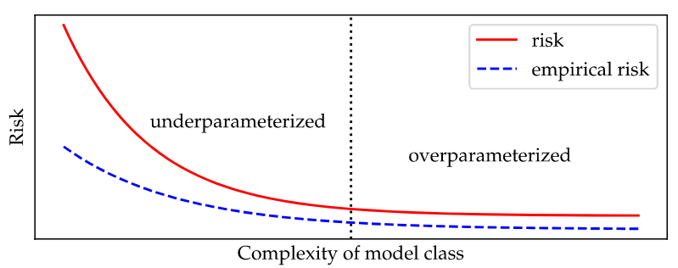
Option A
Using very complex models in a practical application could yield near-zero training loss, but also yield good generalization.
Figure 3. Single descent
Notes:
In fact in many cases, we may find that the risk continues to decrease as the complexity increases, That is, the generalization ability of the model is getting better while the fitting is getting more and more accurate.

Slide 9
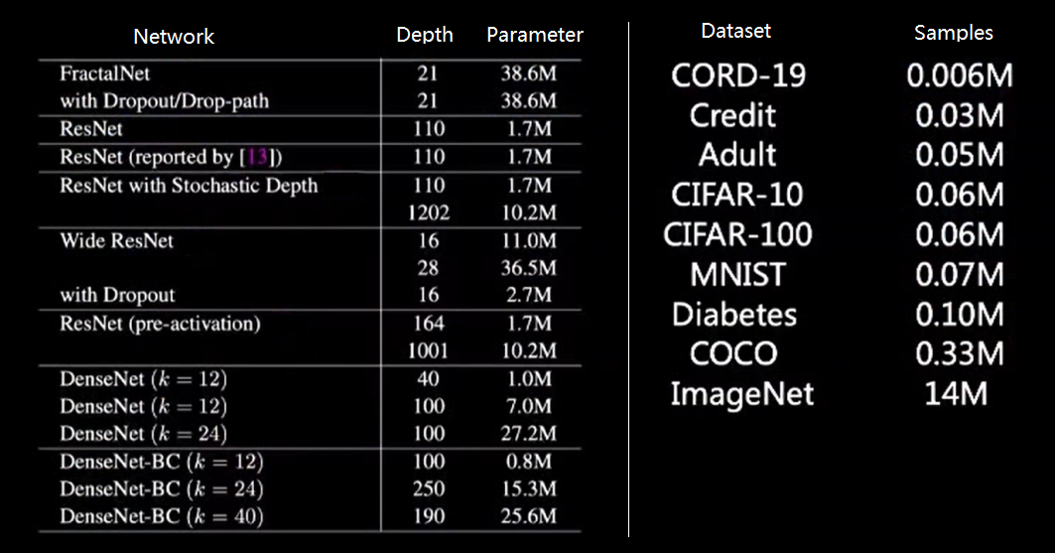
Option A
Figure 4. The quantities of network parameters and dataset samples. On the left is the best neural network in 2017, on the right is the commonly used datasets.
Notes:
An example is the deep neural network models. They may have many layers and very large size, but still generalizing well. As shown in this chart, on the left are the best neural networks in 2017, on the right is the commonly used datasets. We can see most models have more parameters than the number of samples in common datasets. Such complexity does not prevent them from being the best models. Actually the discussion about model complexity and generalization ability never stops.

Slide 10
Option B
Using very complex models in a practical application can lead to over-fitting.
Notes:
Okay, option B, 读题。(click) This is also correct.

Slide 11
Option B
Using very complex models in a practical application can lead to over-fitting.
Not must
Noise: stochastic noise, deterministic noise
The amount of training data is too small
Notes:
It is CAN, but now MUST. As we discussed just now, for the first case, very complex models can lead to over-fitting.
There are actually some other factors that can lead to overfitting, such as noise, including stochastic noise and deterministic noise, and the small size of the training data set.

Slide 12

Option C
In a practical application, regularizing my model correctly guarantees strong generalization.
Notes:
Okay, option C, I also made a mistake on this. 读题，this is incorrect.

Slide 13
Option C
In a practical application, regularizing my model correctly guarantees strong generalization.
In a practical application, regularizing my model correctly guarantees strong generalization.
Notes:
Why not correct？This option is a little tricky.
Correct regularization can help, but not guarantee (click). in addition to regularizition, generalization ability is also affected by many other factors.

Slide 14
Option C
In a practical application, regularizing my model correctly guarantees strong generalization.
Regularizing
Training data size
Noise
Model complexity
……
Notes:
For example, too little training data or too much noise will decrease the generalization performance, and the number of parameters of the model itself will also affect the generalization ability of the model.
Thus, correctly regularizing model can help but not guarantee strong generalization.

Slide 15

Option D
If we think of generalization error as $R\left[f\right]=R_{s}\left[f\right]+ δ_{gen}(f)$, then the act of training a model in function class f seeks to minimize $R_{s}\left[f\right]$, or so-called empirical risk.
Notes:
Option D, 读题. This delta is the generalization gap. This is correct.

Slide 16

Option D
If we think of generalization error as $R\left[f\right]=R_{s}\left[f\right]+ δ_{gen}(f)$, then the act of training a model in function class f seeks to minimize $R_{s}\left[f\right]$, or so-called empirical risk.
Notes:
Training the model is to correct the posterior probability, thereby reducing the training error, that is what we say, the empirical risk. However, training cannot minimize the generalization gap. Generalization gap is decided by the data and the model, which is not affected by training.

Slide 17
Discuss
Model: the more complex the better?
Depends on the real cases!
Notes:
In option A and B, we discussed a lot about the complexity of the model and the generalizing ability. It seems a very complex model can maintain both low risk and strong generalization. So, is the model the more complex the better? (CLICK) This depends on the real cases. More complex models have more parameters to learn, which require more time and computing power, we need to make trade-offs. Also, tuning hyper parameters for complex models may also become difficult.

Slide 18
References
https://zhuanlan.zhihu.com/p/68054009
https://mlstory.org/generalization.html
https://www.cnblogs.com/HuZihu/p/11081463.html
https://zhuanlan.zhihu.com/p/454167581
https://zhuanlan.zhihu.com/p/29707029
http://zh.d2l.ai/chapter_multilayer-perceptrons/underfit-overfit.html
https://picture.iczhiku.com/weixin/message1594467069479.html
Images from: https://www.pngbag.com/png/qjjrxbkq.html
Notes:
Okay, that’s all. Here are the references.

Slide 19




Thank you!
Notes:
Thank you for watching.

